Slide 1
PowerAware
Low-Power Domain Design with UPF
Project Presentation
Goal: Design a low-power digital subsystem, implement power intent using UPF, and validate shutdown,
wake-up, isolation and retention behavior through simulation and checks.
PowerAware – Low-Power Domain Design with UPF | 1

Slide 2
1. Project Overview
Case Study
Design a low-power digital subsystem using modern power-intent methodology.
Partition the design into power domains and define always-on, switchable and retention regions.
Describe power intent with Unified Power Format (UPF).
Validate power-state transitions, isolation and retention through simulation and low-power checks.
Summarize power/performance trade-offs and final project results.
PowerAware – Low-Power Domain Design with UPF | 2

Slide 3
2. Key Objectives & Technical Architecture
Power Domains
UPF Authoring
Always-on, switchable and retention regions
Power switches, isolation and retention strategies
Verification
Optimization
Low-power rule checks and simulation scenarios
Compare baseline and low-power estimates
PowerAware – Low-Power Domain Design with UPF | 3

Slide 4
3. Phase 1 – Power Architecture Planning
Partition the design into logical power domains.
Define an always-on domain for control and power-management logic.
Define a switchable domain for logic that can be powered down to reduce leakage.
Identify retention requirements for state that must survive a power-down event.
Plan the power states and transition rules before UPF implementation.
Always-On
Switchable
Retention
PowerAware – Low-Power Domain Design with UPF | 4

Slide 5
4. Phase 2 – UPF Implementation
Create the UPF power domains and associate RTL instances with each domain.
Add power switches to control the switchable domain.
Add isolation cells to protect always-on logic when the switchable domain is OFF.
Define retention strategies for state-holding elements.
Connect power states and transition rules to describe legal operating modes.
Domains
Power Switch
Isolation
Retention
Power States
PowerAware – Low-Power Domain Design with UPF | 5

Slide 6
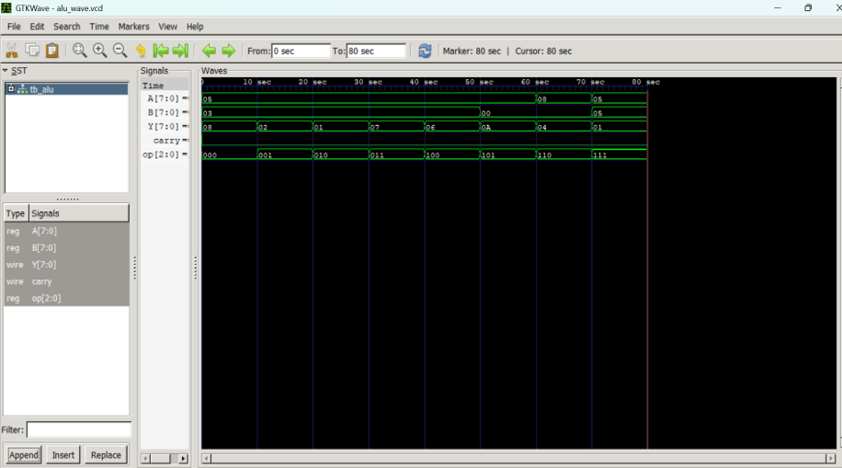
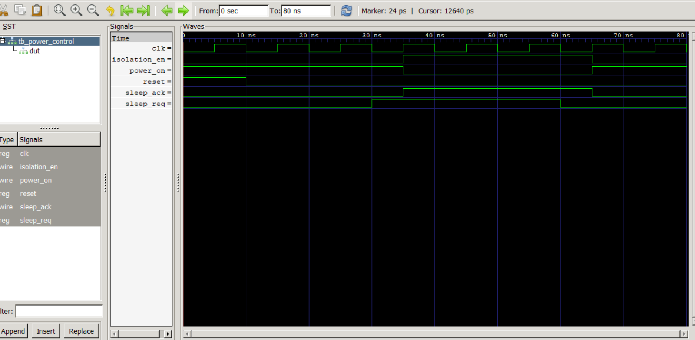
5. Phase 3 – Verification & Simulation
Run low-power rule checks to validate the UPF intent and domain connectivity.
Run simulation scenarios covering normal operation, shutdown and wake-up.
Verify isolation behavior when the switchable domain is powered down.
Verify retention behavior across power-down and wake-up.
Use waveform results to confirm correct power-state transitions.
Simulation artifacts: VCD files + waveform screenshots
PowerAware – Low-Power Domain Design with UPF | 6

Slide 7
6. Final Output & Results
Functional result
RTL + UPF simulation produces the expected functional behavior.
Low-power result
Power-down and wake-up sequences are represented in the simulation flow.
Verification result
Waveform evidence and low-power checks support the intended power-state behavior.
Final artifacts
Source code, simulation/VCD files, final outputs and documentation are organized in the project folder.
PowerAware – Low-Power Domain Design with UPF | 7

Slide 8
7. Phase 4 – Power Optimization Summary
Compare the baseline design with the low-power implementation.
Evaluate the effect of power switches, isolation and retention cells.
Report area and timing impact introduced by low-power cells.
Summarize the power/performance trade-off and identify the benefit of power-domain shutdown.
Use measured/simulated results from the project rather than assuming ideal savings.
Power ↓
Area ↕
Timing ↕
PowerAware – Low-Power Domain Design with UPF | 8

Slide 9
8. Deliverables
1. UPF files and power-domain documentation.
2. Low-power verification logs and simulation evidence.
3. Power/performance trade-off report.
4. RTL/source code and supporting project files.
5. Final presentation and project handoff package.
Project organization
• Documentation/
• source_code/
• Simulation/
• Final/
• Github/
• presentation/
PowerAware – Low-Power Domain Design with UPF | 9

Slide 10
9. Project Timeline & Deadlines
Week 1
Week 2
Week 3
Week 4
Domain partition and
power strategy.
UPF implementation.
Low-power verification.
Analysis and final handoff.
Final handoff should include the design files, verification evidence, analysis and presentation.
PowerAware – Low-Power Domain Design with UPF | 10

Slide 11
10. Conclusion
Final Handoff
PowerAware demonstrates a practical low-power design flow using UPF.
• Power domains define when logic is powered and controlled.
• Isolation and retention preserve correct behavior across power-state changes.
• Simulation and low-power checks provide verification evidence.
• The final analysis captures power benefits together with area/timing trade-offs.
PowerAware – Low-Power Domain Design with UPF | 11

